Slide 1
Machine Learning Algorithms (III-III)
Master´s in Applied Artificial Intelligence
Luís Ferreira
lufer@ipca.pt

Slide 2
Overview
Part I
Artificial Intelligence and Machine Learning
Foundations
Part II
Machine Learning
Part III
Machine Learning Algorithms
Parte IV
Deep Learning & Neural Networks
Parte V
Building a ML Model

Slide 3
Part III
Machine Learning Algorithms
Competencies to be acquired:
Data Correlation
Feature selection techniques

Slide 4
Part III: MLA
Modelling (Review)
Remember the essential steps:
  Training a model
  Tuning the model:
    Hyperparameter tuning; Experiment Evaluation
  Testing and Comparing results

Slide 5
Part III: MLA
Modelling (Review)
Get the Data ready to be used im ML
  Split the data into features and labels (usually ‘X’ and ‘y’)
  Filling (also called imputing) or disregarding missing values:
  Converting non-numerical values to numerical values (also called feature encoding)

Slide 6
Part III: MLA
Modelling (Review)
Get the Data ready to be used im ML
  Split the data into features and labels (usually ‘X’ and ‘y’)
  Filling (also called imputing) or disregarding missing values:
  Converting non-numerical values to numerical values (also called feature encoding)

Slide 7


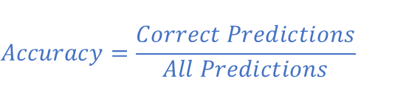
Part III - MLA
Modelling Evaluation (Review)
Evaluation Metrics
$$Accuracy=\frac{Correct Predictions}{All Predictions}$$
$$Precision=\frac{tp}{tp+fp}$$
$$Recall=\frac{tp}{tp+fn}$$
Notes:
Precision k : Example: Top10 (k=10)

Slide 8
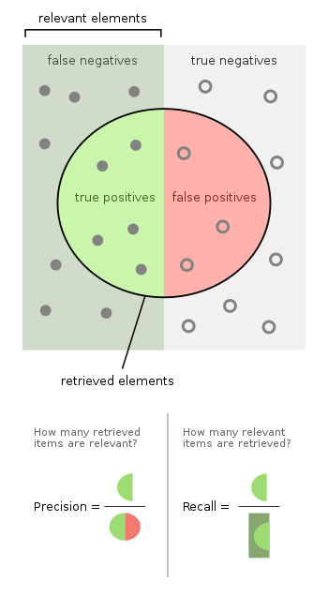
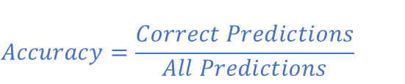


Part III - MLA
Modelling Evaluation (Review)
Evaluation Metrics
$$Accuracy=\frac{Correct Predictions}{All Predictions}$$
$$Precision=\frac{tp}{tp+fp}$$
$$Recall=\frac{tp}{tp+fn}$$
Notes:
Precision k : Example: Top10 (k=10)

Slide 9
Part III - MLA
Modelling Evaluation
Correlation
  Relation among two variables (x,y), i.e., the mutual relationship, covariation, or association between two or more variables!
  It is concerned with the measurement of simultaneous variations in both variables!
  It is not Causation!!!!
Notes:
Precision k : Example: Top10 (k=10)

Slide 10
Part III - MLA
Modelling Evaluation
Correlation
  Relation among two variables (x,y), i.e, the mutual relationship, covariation, or association between two or more variables!
  It is concerned with the measurement of simultaneous variations in both variables!
  It is not Causation!!!!
Example:
The fur colour of the cubs and the father wolf are correlated. But it can't be said that the father's colour is caused by the determination only by the colour of his son's fur.
Notes:
Causation == Causalidade
Não podemos afirmar que isso acontecerá para todos os casos

Slide 11
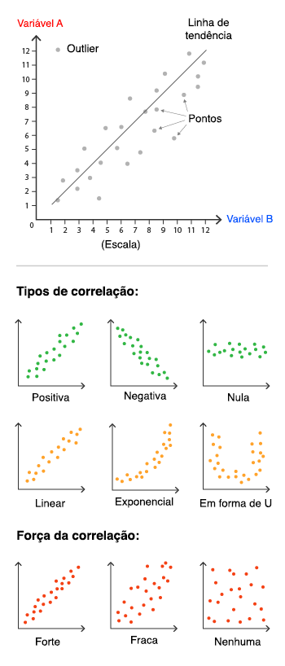
Part III - MLA
Modelling Evaluation
Correlation
  Positive: if both variables increase or decrease
    variable X increases and another variable Y also
    increases in a similar way
  Negative: variables are inversely proportional
    If one decreases and the other increases
Notes:
Precision k : Example: Top10 (k=10)

Slide 12
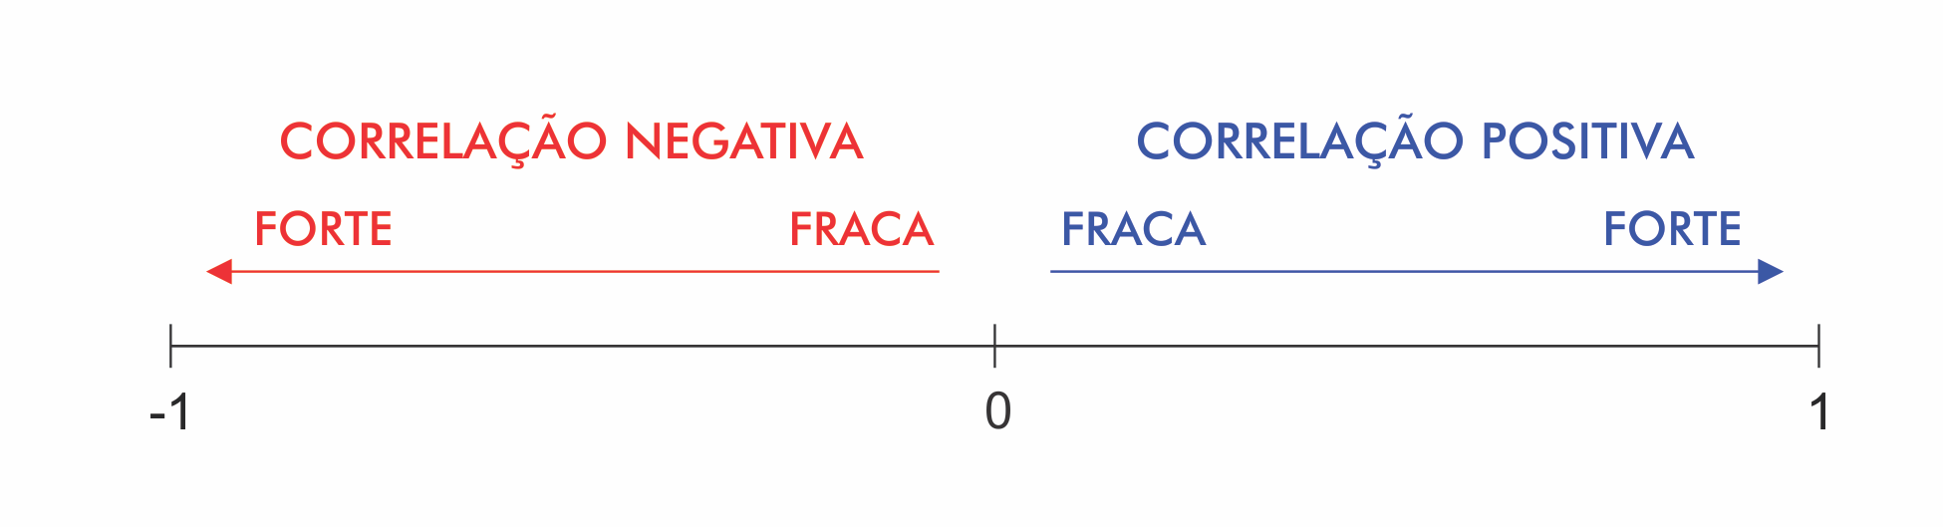
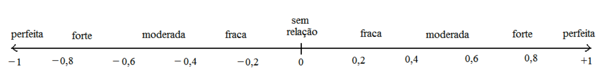
Part III - MLA
Modelling Evaluation
Correlation
  Positive: if both variables increase or decrease
    variable X increases and another variable Y also increases in a similar way
  Negative: variables are inversely proportional
    If one decreases and the other increases
Notes:
Precision k : Example: Top10 (k=10)

Slide 13
Part III - MLA
Modelling Evaluation
Correlation
  Linear
  U-Form
  Exponential
Notes:
https://escoladedados.org/tutoriais/correlacao-nao-e-causalidade-mas-o-que-e-entao/

Slide 14
Part III - MLA
Modelling Evaluation
Correlation in Machine Learning
  Metrics for bivariate correlation: Pearson’s r | Spearman's rho (r_{s}) | Kendall's Tau (τ)
    Pearson’s correlation (r) (+1 to -1) quantitative variables
    Spearman’s rho correlation (ρ) (+1 to -1) quantitative | qualitative
    Kendall’s Tau correlation (τ) (‘+1 to -1) ordinal
  Important to select the most relevant features!
  Data having non-correlated features have many benefits
Notes:
https://statplace.com.br/blog/coeficientes-de-correlacao/

Slide 15
Part III - MLA
Modelling Evaluation
Correlation in Machine Learning
  Pearson’s r
    Requires normally distributed continuous variables!
  Spearman’s r_{s} and Kendall’s τ
    For non-normal distributions (datasets with extreme values, outliers);
    Coefficients should be calculated from the ranks of the data, not from their actual values!
    It should be used when the same rank is repeated too many times in a small dataset!
Notes:
https://statplace.com.br/blog/coeficientes-de-correlacao/

Slide 16
Part III - MLA
Modelling Evaluation
Correlation in Machine Learning
  Pearson’s r
    Requires normally distributed continuous variables!
  Spearman’s r_{s} and Kendall’s τ
    For non-normal distributions (datasets with extreme values, outliers);
    Coefficients should be calculated from the ranks of the data, not from their actual values!
    It should be used when the same rank is repeated too many times in a small dataset!
Normality is essential for the calculation of the significance and confidence intervals, not the correlation coefficient itself.
Notes:
https://statplace.com.br/blog/coeficientes-de-correlacao/

Slide 17
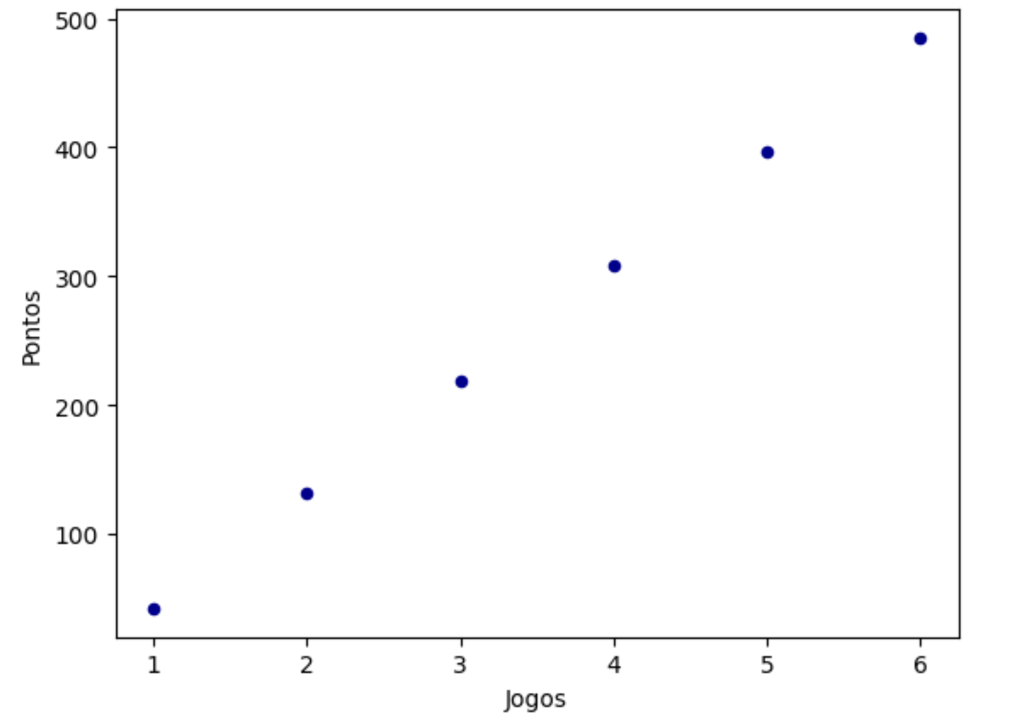
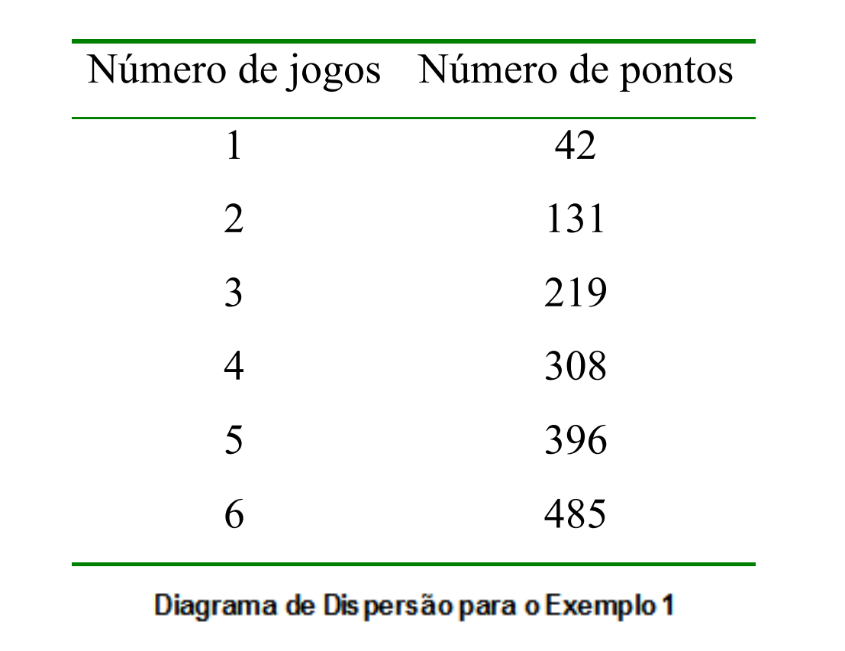
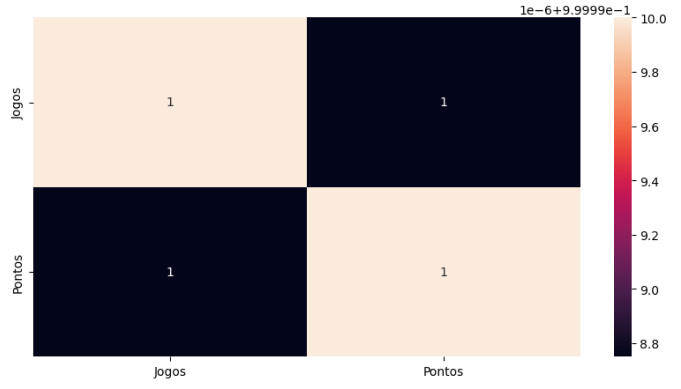
Part III - MLA
Modelling Evaluation
Calculus of the Correlation
  First, check the relationship linearity by a:
    Scatterplot ^{(a)}
    Correlation matrix ^{(b)}
(a)
(b)
Notes:
https://statplace.com.br/blog/coeficientes-de-correlacao/

Slide 18
Part III - MLA
Modelling Evaluation
Correlation in Machine Learning
  Metrics:
    Pearson’s correlation of coefficient (r) (+1 to -1) quantitative variables
    Spearman’s correlation of coefficient rho (ρ) (+1 to -1) quantitative | qualitative
    Kendall’s Tau correlation of coefficient tau (τ) (‘+1 to -1) ordinal
  Important to select the most relevant features!
  Data having non-correlated features have many benefits
Data having non-correlated features have many benefits:
  1. Learning of Algorithm will be faster
  2. Interpretability will be high
  3. Bias will be less
Notes:
https://statplace.com.br/blog/coeficientes-de-correlacao/

Slide 19
Part III - MLA
Modelling Evaluation
Variables can be classified as follows:
Quantitative Variables: these are characteristics that can be measured on a quantitative scale, i.e. they have numerical values that make sense. They can be continuous or discrete.
  Discrete variables: measurable characteristics that can only take on a finite or infinite countable number of values and therefore only integer values make sense. They are usually the result of counting. Examples: number of children, number of bacteria per litre of milk, number of cigarettes smoked per day.
  Continuous variables, measurable characteristics that take on values on a continuous scale (on the real line), for which fractional values make sense. They usually have to be measured using an instrument. Examples: weight (scale), height (ruler), time (clock), blood pressure, age.
Qualitative (or categorical) variables: these are characteristics that do not have quantitative values, but instead are defined by various categories, i.e. they represent a classification of individuals. They can be nominal or ordinal.
  Nominal variables: there is no ordering among the categories. Examples: sex, eye colour, smoker/non-smoker, sick/sad.
  Ordinal variables: there is an ordering between the categories. Examples: schooling (1st, 2nd, 3rd grade), stage of illness (initial, intermediate, terminal), month of observation (January, February,..., December).
Correlation in Machine Learning
  Metrics:
    Pearson’s correlation of coefficient (r) (+1 to -1) quantitative variables
    Spearman’s correlation of coefficient rho (ρ) (+1 to -1)
    Kendall’s Tau correlation of coefficient tau (τ) (‘+1 to -1)
  Important to select the most relevant features!
  Data having non-correlated features have many benefits
Notes:
https://statplace.com.br/blog/coeficientes-de-correlacao/

Slide 20
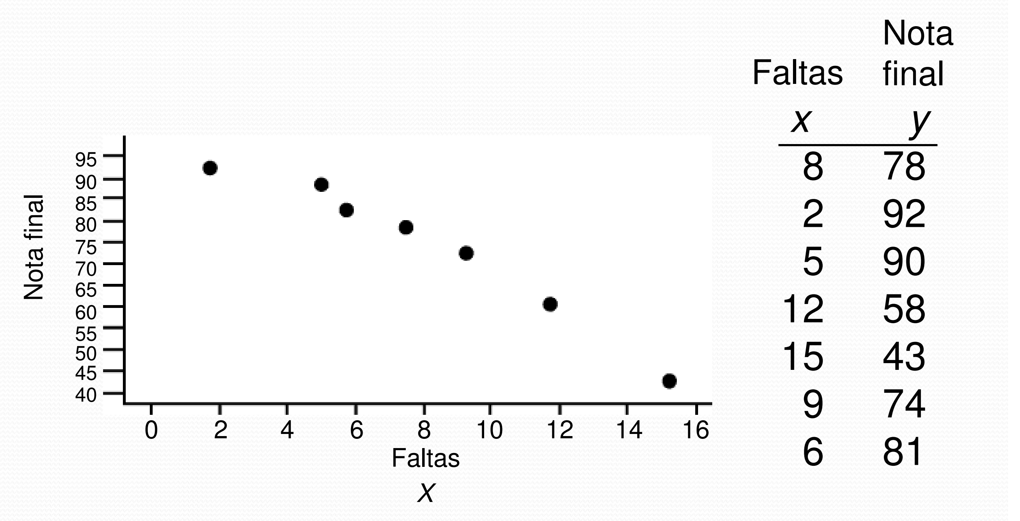
Part III - MLA
Modelling Evaluation
Is there any correlation?
r = ?
ρ = ?
Exercise: Calculate in Pandas?
Correlation
  Positive: if both variables increases
    variable X increases and another variable Y also increases in a similar way
  Negative: if both variables decreases
    If one decreases along with the other
Notes:
https://statplace.com.br/blog/coeficientes-de-correlacao/

Slide 21
Part III - MLA
Modelling Evaluation
Multiple Correlation (many variables can be involved)
  Is there another variable that influences my model?
  Read more about it!
Notes:
https://statplace.com.br/blog/coeficientes-de-correlacao/

Slide 22
Part III - MLA
Modelling Evaluation
Interesting “false” relations:
  The old Post-Hoc fallacy, i.e. if A happened after B, then B caused A;
  Change of position between variables
  Deduction that the real correlation will maintain a strong relationship beyond the data with which it has been demonstrated
Notes:
1 - “…com uma dor de cabeça terrível, ao tomar um copo d’água, começo a me sentir melhor..”
2 - ”…se uma pessoa é rica porque tem ações do mercado financeiro, ou se tem ações porque é rica…”
3 - “…tudo em excesso faz mal”…Uma planta não sobrevive sem água, mas experimente despejar torrentes de água nela por um tempo e veja se ela não morre!...”

Slide 23
Part III - MLA
Modelling Evaluation
Example of multiple variables (cor)related:
Imagine you're a farmer and you want to predict crop yields. If you calculate the correlation coefficient between Y (crop yield) and X1 (rainfall), suppose the result is 0. In other words, there is no correlation between yield and rainfall.
Now suppose we have another variable X2 (temperature). The partial correlation between Y (yield) and X2 (temperature) is positive; the partial correlation between X2 (temperature) and X1 (rainfall) is negative.
By calculating the partial correlation between yield and rainfall, keeping the temperature constant, it will exist and the coefficient will be positive. It sounds confusing, but it's not. Since temperature influences both harvest and rainfall in different ways, when we analyse the relationship between harvest and rainfall from this perspective, there is a correlation.
Econometria Básica, Dawn C. Porter e Damodar Gujarati, 2011
Interesting “false” relations:
  The old Post-Hoc fallacy, i.e. if A happened after B, then B caused A;
  Change of position between variables
  Deduction that the real correlation will maintain a strong relationship beyond the data with which it has been demonstrated
Notes:
1 - “…com uma dor de cabeça terrível, ao tomar um copo d’água, começo a me sentir melhor..”
2 - ”…se uma pessoa é rica porque tem ações do mercado financeiro, ou se tem ações porque é rica…”
3 - “…tudo em excesso faz mal”…Uma planta não sobrevive sem água, mas experimente despejar torrentes de água nela por um tempo e veja se ela não morre!...”
Crop yields – rendimento das colheitas

Slide 24
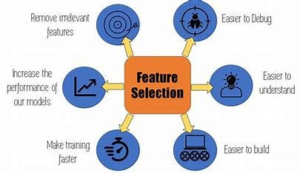
Part III - MLA
Modelling Evaluation
Selecting Features in datasets:
  To reduce the dimensionality of feature space.
  To speed up a learning algorithm.
  To improve the predictive accuracy of a classification algorithm.
  To improve the comprehensibility of the learning result

Slide 25
Part III - MLA
Modelling Evaluation
Selecting Features in datasets:
  Main Goal: reduce the dimensionality of the model
    What to ignore? What to consider? What to improve?
    First: get the variables correlation
    Second: check the significance
      Local significance (or relevance) – for predicting specific data!
      Global significance – involve all data

Slide 26
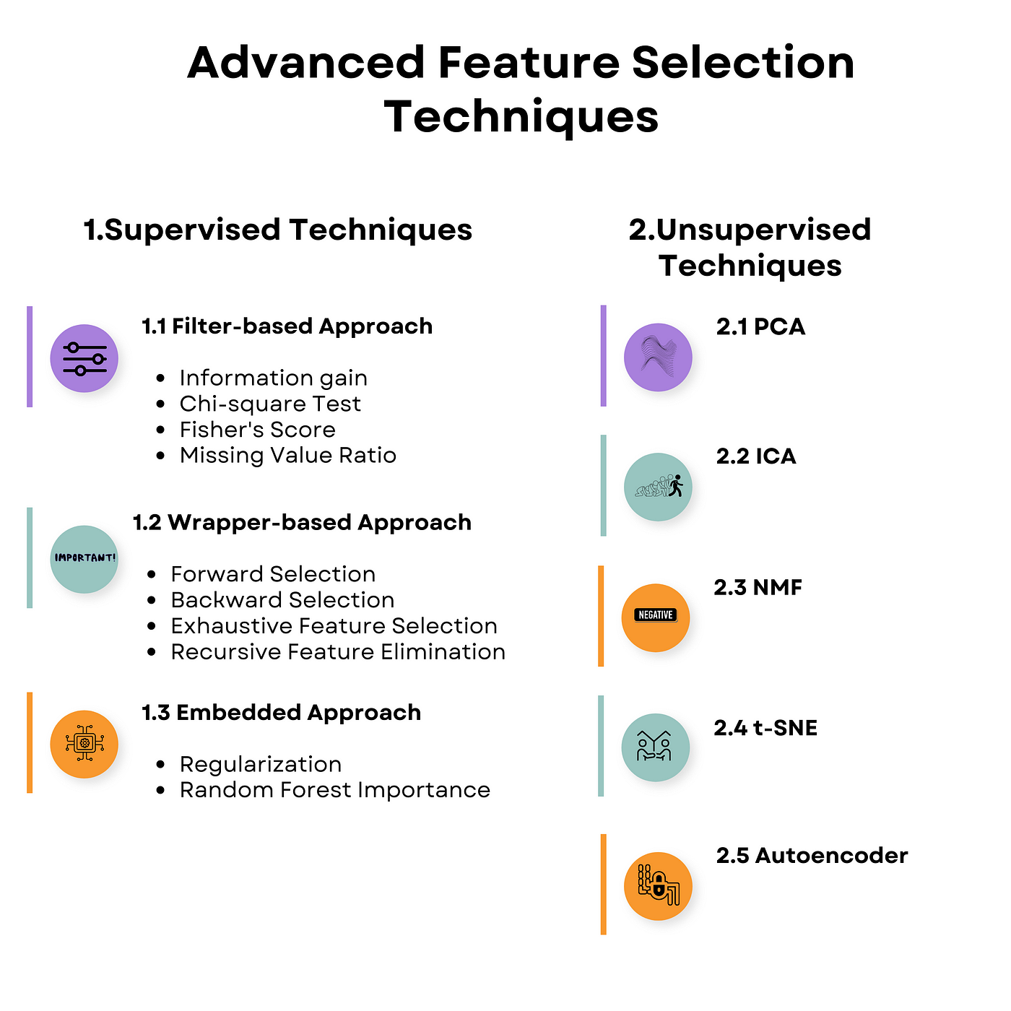
Part III - MLA
Modelling Evaluation
Selecting Features in datasets:
  Filter Methods
  Wrapper Methods
  Embedded Methods
Notes:
https://medium.com/mlearning-ai/feature-selection-techniques-in-machine-learning-82c2123bd548

Slide 27
Part III - MLA
Features Selection
Filter Methods
  Pick up the intrinsic properties of the features measured via univariate statistics!
    Correlation Coefficient
    Information Gain
    Chi-square Test
    Fisher’s Score
    Variance Threshold
    Mean Absolute Difference (MAD)

Slide 28
Part III - MLA
Features Selection
Wrapper Methods
  Usually result in better predictive accuracy than filter methods!
  Is a technique that selects a subset of features by evaluating a model’s performance using different subsets of features
    Forward Feature Selection
    Backward Feature Elimination
    Exhaustive Feature Selection
    Recursive Feature Elimination

Slide 29
Part III - MLA
Features Selection
Embedded Methods
  Encompass the benefits of both the wrapper and filter methods by including interactions of features!
  Are iterative in the sense that takes care of each iteration of the model training process and carefully extract those features which contribute the most to the training for a particular iteration
    LASSO Regularization (L1)
    Random Forest Importance
Notes:
https://www.analyticsvidhya.com/blog/2020/10/feature-selection-techniques-in-machine-learning/

Slide 30
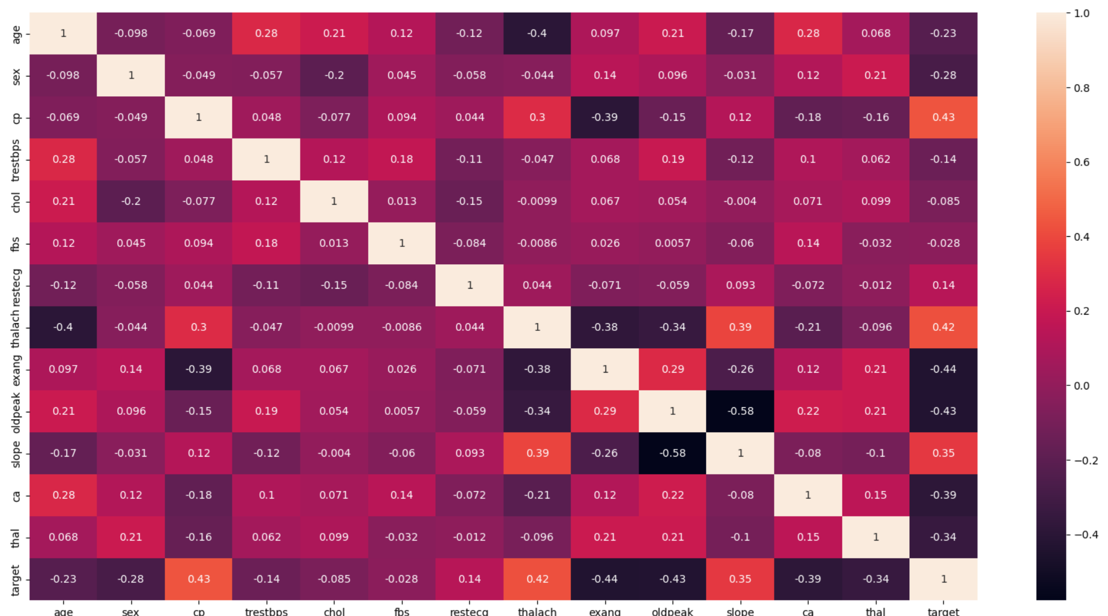
Part III - MLA
Features Selection
Filter Methods: Correlation
    Numerical values: Pearson’s r
    Good variables correlate highly with the target
    Variables should be correlated with the target but uncorrelated among themselves
    If two features are correlated, the model only needs one, as the second does not add additional information!
    If we find that the predictor variables are correlated, we can drop the variable with a lower correlation coefficient value than the target variable!

Slide 31
Part III - MLA
Modelling Evaluation

Slide 32
Part III - MLA
Explore
Data Correlation
  Jupyter Notebook
  4_Data_Manipulation_Modelling_II.ipynb
Notes:
https://statplace.com.br/blog/coeficientes-de-correlacao/

Slide 33
Progress
Part I
Artificial Intelligence and Machine Learning
Foundations
Part II
Machine Learning
Part III
Machine Learning Algorithms (I)
Part IV
Machine Learning Algorithms (I)
Part V
Deep Learning & Neural Networks

Slide 34
References
Feature Selection Techniques in Machine Learning
  https://www.analyticsvidhya.com/blog/2020/10/feature-selection-techniques-in-machine-learning/
How to Choose a Feature Selection Method For Machine Learning
  https://machinelearningmastery.com/feature-selection-with-real-and-categorical-data/

Slide 35
References
The Lifecycle of an AI
  https://labelyourdata.com/articles/lifecycle-of-an-ai-project-stages-breakdown#step_4_scrub_your_data_clean
Examples of Machine Learning Projects
  https://www.datacamp.com/blog/machine-learning-projects-for-all-levels
Elements of AI (free online course)
  https://www.elementsofai.com/

Slide 36
References
Google Colab
  https://colab.research.google.com/
Pandas Tutorial
  https://www.w3schools.com/python/pandas/ref_df_sample.asp

Slide 37
References
Machine Learning. Tom M. Mitchel, McGraw-Hill, 1997
Machine Learning for Everyone
  https://vas3k.com/blog/machine_learning/
Machine Learning Tutorial
  https://www.simplilearn.com/tutorials/machine-learning-tutorial/machine-learning-steps
What is machine learning and how does it work? In-depth guide
  https://www.techtarget.com/searchenterpriseai/definition/machine-learning-ML

Slide 38
Appendices

Slide 39
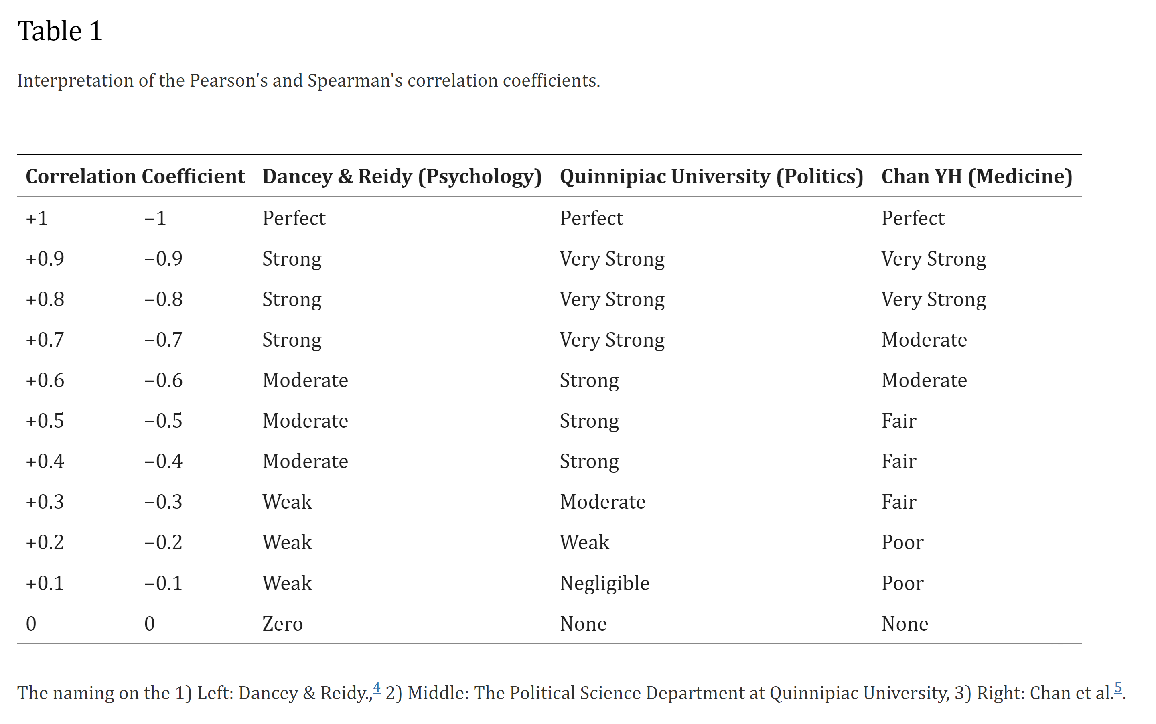
Notes:
https://vas3k.com/blog/machine_learning/

